Slide 1
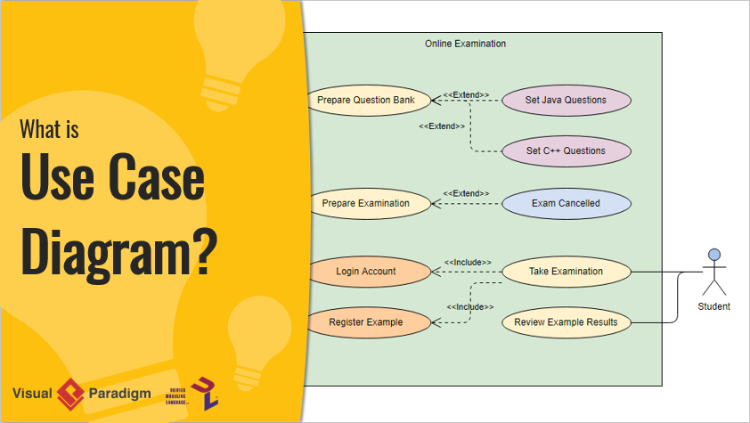

Slide 2
What is Use Case Diagram?
What is Use Case Diagram?
Here are some questions that have been asked frequently in the UML world are: What is a use case diagram? Why Use case diagram? or simply, Why use cases?.

Slide 3
of what is a use case diagram?
A UML use case diagram is the primary form of system/software requirements for a new software program underdeveloped.
Use cases specify the expected behavior (what), and not the exact method of making it happen (how). Use cases once specified can be denoted both textual and visual representation (i.e. use case diagram).
A key concept of use case modeling is that it helps us design a system from the end user's perspective. It is an effective technique for communicating system behavior in the user's terms by specifying all externally visible system behavior.

Slide 4
A use case diagram is usually simple. It does not show the detail of the use cases:
It only summarizes some of the relationships between use cases, actors, and systems.
It does not show the order in which steps are performed to achieve the goals of each use case.
As said, a use case diagram should be simple and contains only a few shapes. If yours contain more than 20 use cases, you are probably misusing use case diagram.
The figure below shows the UML diagram hierarchy and the positioning of the UML Use Case Diagram. As you can see, use case diagrams belong to the family of behavioral diagrams.

Slide 5
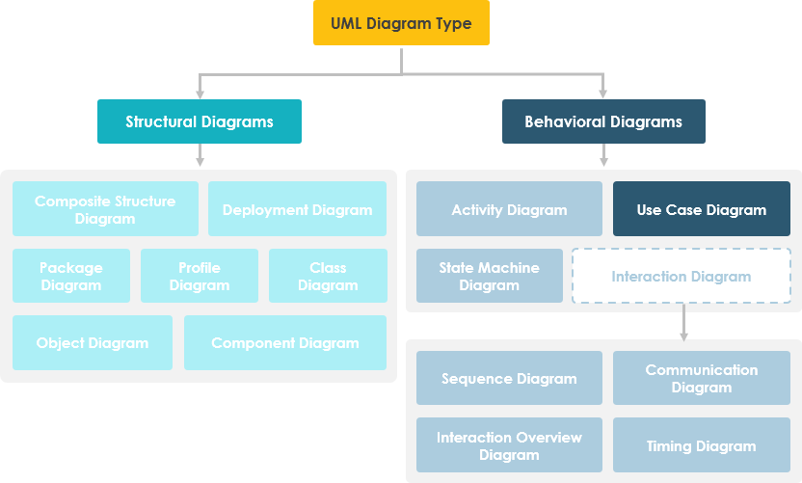

Slide 6
Note that:
There are many different UML diagrams that serve different purposes (as you can see from the UML diagram tree above). You can describe those details in other UML diagram types and documents, and have them be linked from use cases.
Use cases represent only the functional requirements of a system. Other requirements such as business rules, quality of service requirements, and implementation constraints must be represented separately, again, with other UML diagrams.

Slide 7
Origin of Use Case
These days use case modeling is often associated with UML, although it has been introduced before UML existed. Its brief history is as follow:
In 1986, Ivar Jacobson first formulated textual and visual modeling techniques for specifying use cases.
In 1992 his co-authored book Object-Oriented Software Engineering - A Use Case Driven Approach helped to popularize the technique for capturing functional requirements, especially in software development.

Slide 8
Purpose of Use Case Diagram
Use case diagrams are typically developed in the early stage of development and people often apply use case modeling for the following purposes:
Specify the context of a system
Capture the requirements of a system
Validate a systems architecture
Drive implementation and generate test cases
Developed by analysts together with domain experts

Slide 9
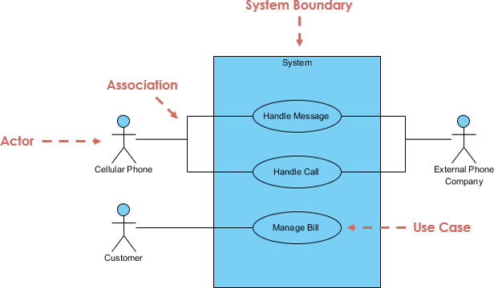
Use Case Diagram at a Glance
A standard form of use case diagram is defined in the Unified Modeling Language as shown in the Use Case Diagram example below:

Slide 10
Notation Description
Actor
Someone interacts with use case (system function).
Named by noun.
Actor plays a role in the business
Similar to the concept of user, but a user can play different roles
For example:
A prof. can be instructor and also researcher
plays 2 roles with two systems
Actor triggers use case(s).
Actor has a responsibility toward the system (inputs), and Actor has expectations from the system (outputs).

Slide 11

Use Case
System function (process - automated or manual)
Named by verb + Noun (or Noun Phrase).
i.e. Do something
Each Actor must be linked to a use case, while some use cases may not be linked to actors.

Slide 12
Communication Link
The participation of an actor in a use case is shown by connecting an actor to a use case by a solid link.
Actors may be connected to use cases by associations, indicating that the actor and the use case communicate with one another using messages.

Slide 13
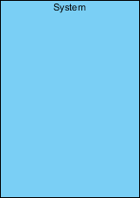
Boundary of system
The system boundary is potentially the entire system as defined in the requirements document.
For large and complex systems, each module may be the system boundary.
For example, for an ERP system for an organization, each of the modules such as personnel, payroll, accounting, etc.
can form a system boundary for use cases specific to each of these business functions.
The entire system can span all of these modules depicting the overall system boundary

Slide 14
Use Case Relationship
Extends
indicates that an "Invalid Password" use case may include (subject to specified in the extension) the behavior specified by base use case "Login Account".
Depict with a directed arrow having a dotted line. The tip of arrowhead points to the base use case and the child use case is connected at the base of the arrow.
The stereotype "<<extends>>" identifies as an extend relationship

Slide 15


Slide 16
Include
When a use case is depicted as using the functionality of another use case, the relationship between the use cases is named as include or uses relationship.
A use case includes the functionality described in another use case as a part of its business process flow.
A uses relationship from base use case to child use case indicates that an instance of the base use case will include the behavior as specified in the child use case.
An include relationship is depicted with a directed arrow having a dotted line. The tip of arrowhead points to the child use case and the parent use case connected at the base of the arrow.
The stereotype "<<include>>" identifies the relationship as an include relationship.

Slide 17


Slide 18
Generalization
A generalization relationship is a parent-child relationship between use cases.
The child use case is an enhancement of the parent use case.
Generalization is shown as a directed arrow with a triangle arrowhead.
The child use case is connected at the base of the arrow. The tip of the arrow is connected to the parent use case.

Slide 19

Use Case Examples
Use Case Example - Association Link
A Use Case diagram illustrates a set of use cases for a system, i.e. the actors and the relationships between the actors and use cases.

Slide 20
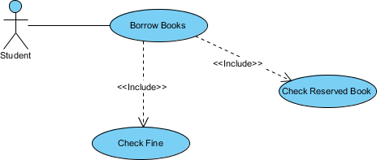
Use Case Example - Include Relationship
The include relationship adds additional functionality not specified in the base use case. The <<Include>> relationship is used to include common behavior from an included use case into a base use case in order to support the reuse of common behavior.

Slide 21
Use Case Example - Extend Relationship
The extend relationships are important because they show optional functionality or system behavior. The <<extend>> relationship is used to include optional behavior from an extending use case in an extended use case.
Take a look at the use case diagram example below. It shows an extend connector and an extension point "Search".

Slide 22


Slide 23
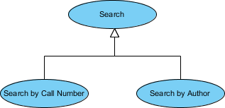
Use Case Example - Generalization Relationship
A generalization relationship means that a child use case inherits the behavior and meaning of the parent use case.
The child may add or override the behavior of the parent. The figure below provides a use case example by showing two generalization connectors that connect between the three use cases.

Slide 24
Use Case Diagram - Vehicle Sales Systems
The figure below shows a use case diagram example for a vehicle system. As you can see even a system as big as a vehicle sales system contains not more than 10 use cases! That's the beauty of use case modeling.
The use case model also shows the use of extend and include. Besides, there are associations that connect between actors and use cases.

Slide 25
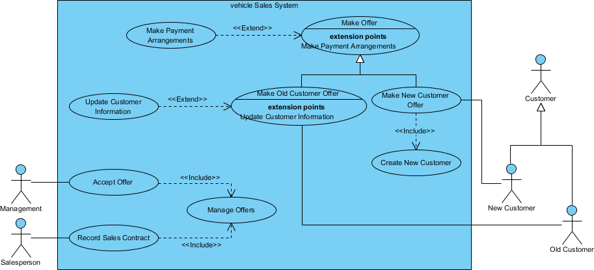

Slide 26
How to Identify an Actor
Often, people find it easiest to start the requirements elicitation process by identifying the actors.
The following questions can help you identify the actors of your system (Schneider and Winters - 1998):

Slide 27
Who uses the system?
Who installs the system?
Who starts up the system?
Who maintains the system?
Who shuts down the system?
What other systems use this system?
Who gets information from this system?
Who provides information to the system?
Does anything happen automatically at a present time?

Slide 28
How to Identify Use Cases?
Identifying the Use Cases, and then the scenario-based elicitation process carries on by asking what externally visible, observable value that each actor desires.
The following questions can be asked to identify use cases, once your actors have been identified (Schneider and Winters - 1998):
What functions will the actor want from the system?
Does the system store information? What actors will create, read, update or delete this information?
Does the system need to notify an actor about changes in the internal state?
Are there any external events the system must know about? What actor informs the system of those events?

Slide 29
Use Case Diagram Tips
Now, check the tips below to see how to apply use case effectively in your software project.
Always structure and organize the use case diagram from the perspective of actors.
Use cases should start off simple and at the highest view possible. Only then can they be refined and detailed further.
Use case diagrams are based upon functionality and thus should focus on the "what" and not the "how".

Slide 30
Note that:
While a use case itself might drill into a lot of detail about every possibility, a use-case diagram is often used for a higher-level view of the system as blueprints.
It is beneficial to write use cases at a coarser level of granularity with less detail when it's not required.
I hope you can answer "what is use case diagram" now and can apply use case in your project.

